Slide 1
Project Presentation of Industry Oriented Hands on Experience (22CS422)
On
Can you improve chatbot capabilities to enhance conversational AI?
Simran Kaur : 2210990852
Supervised By:
Dr. Gurpreet Singh
Department of Computer Science and Engineering,
Chitkara University, Punjab

Slide 2
Introduction
Digital transformation has increased the use of conversational interfaces in modern applications.
Chatbots are widely used in customer support, healthcare, e-commerce, and virtual assistance..
Traditional rule-based chatbots rely on predefined rules and struggle with dynamic user queries.
They often fail in intent recognition, context retention, and multi-turn conversations.
Modern NLP techniques and transformer models such as BERT and GPT improve chatbot intelligence.
Sentiment analysis enables chatbots to understand user emotions and generate personalized responses.

Slide 3
Problem Statement & Objectives
Traditional rule-based chatbots struggle to handle ambiguous and dynamic user queries.
They often fail to preserve conversation context in multi-turn interactions.
Lack of sentiment understanding reduces personalization and user satisfaction.
Existing chatbot systems generate irrelevant or inconsistent responses.
The proposed system integrates NLP, transformer models, and sentiment analysis to improve chatbot performance.
Objectives include improving intent recognition, context awareness, response accuracy, and conversational continuity.

Slide 4
Tools and Technology
Programming Language: Python
Framework: Flask
Frontend Technologies: HTML, CSS, JavaScript
Natural Language Processing: TextBlob, NLTK
Transformer Model: Hugging Face Transformers (FLAN-T5)
Machine Learning Library: PyTorch
Data Storage: JSON for structured logging
Development Environment: Visual Studio Code

Slide 5
Methodology
The first system was a traditional rule-based chatbot using predefined patterns and scripted responses.
The second system was an AI-enabled chatbot developed using NLP and transformer models.
01
02
Both systems were tested on conversational scenarios including ambiguous queries, and multi-turn conversations
Sentiment analysis was integrated to detect user emotions and generate personalized responses.
06
03
Structured logging was used to record user inputs, detected intents, and chatbot responses.
Context management was implemented to preserve conversation history in multi-turn interactions.
05
04

Slide 6
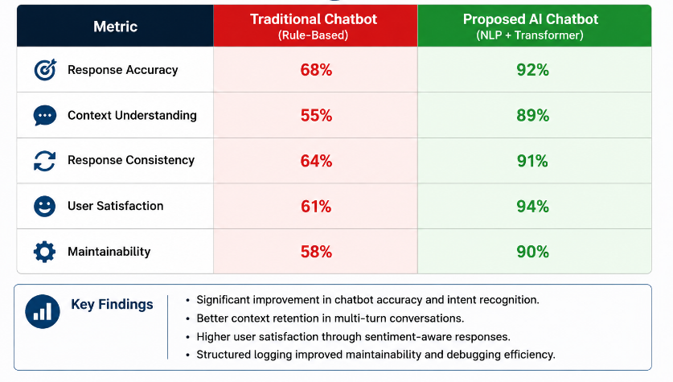
Results and Performance

Slide 7
Benefits and Challenges
Integration improves response speed, automation accuracy, and operational efficiency.
It reduces repetitive human effort and supports scalable enterprise deployment.
01
02
Cost reduction and improved customer handling are major advantages.
Challenges include legacy system compatibility and compliance requirements.
03
04
Model drift and continuous retraining are also important considerations.
Human-AI collaboration remains essential for complex cases
05
06

Slide 8
Conclusion
The proposed AI-enabled chatbot system outperforms traditional rule-based chatbots.
Integration of NLP techniques and transformer models improves response accuracy and intent recognition.
Context management enables better handling of multi-turn conversations.
Sentiment analysis improves personalization and user interaction quality.
Structured logging enhances debugging, monitoring, and maintainability of the chatbot system.
The proposed framework contributes to building scalable, intelligent, and user-friendly conversational AI systems.

Slide 9
Future Scope
01
04
Integration of advanced monitoring and visualization tools for chatbot performance analysis.
Performance benchmarking to optimize response time and computational efficiency.
Future Scope
Deployment of the chatbot system across larger datasets and multiple domains.
Application of anomaly detection techniques for identifying conversational issues.
02
05
Implementation of scalable conversational architectures for handling high user traffic.
Further enhancement of chatbot models using improved NLP and machine learning techniques.
03
06

Slide 10
Thank You

